Slide 1









Whiteboardmaths.com
7
2
1
5
© 2004 All rights reserved

Slide 2

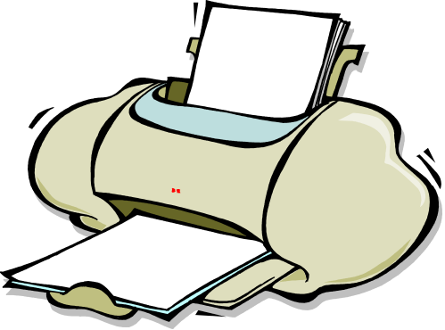

Reverse Percentages
A computer accessories shop increased the price of all its printers on Friday afternoon by 10%. Jenny bought a printer the following Monday morning for £100. How much would she have paid for it had she bought it on Friday?
- 10% ?
£?
£100
+ 10%
Original Price
New Price
Note that the answer cannot be £90 since £90 + 10% of £90 = £90 + £9 = £99 and not £100
£90.91
(to the nearest penny)
So you cannot calculate the original price by simply taking 10% off the new price. So what do we do?

Slide 3
Reverse Percentages
A computer accessories shop increased the price of all its printers on Friday afternoon by 10%. Jenny bought a printer the following Monday morning for £100. How much would she have paid for it had she bought it on Friday?
£?
£100
+ 10%
WE FIND A MULTIPLIER
Original Price
New Price
The new price is 110% of the old price = 110/100 = 1.1 times larger.
£90.91
(to the nearest penny)
So in this case the multiplier is 1.1
So if x is the original price then: 1.1 x = 100 ⇒ x = 100/1.1 = £90.91

Slide 4


Reverse Percentages
Simon bought a more expensive printer that included a fax machine and scanner. These had gone up in price by 12%. What would Simon have paid for this on Friday (nearest penny)
£?
£230
+ 12%
Original Price
New Price
The multiplier is 112/100 = 1.12
£205.36
(to the nearest penny)
1.12 x = 230 ⇒ x = 230/1.12 = £205.36

Slide 5
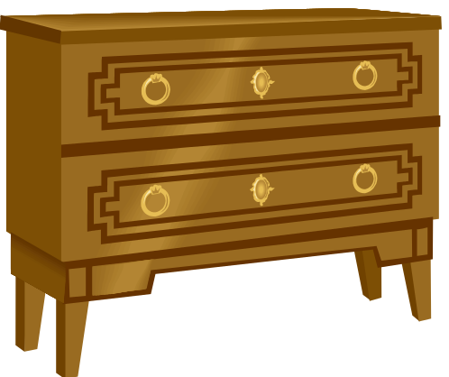
Reverse Percentages
Calculate the original price of the sideboard shown after it had been increased in price by the indicated percentage.
£?
£540
+ 23%
Original Price
New Price
The multiplier is 123/100 = 1.23
£439.02
(to the nearest penny)
1.23 x = 540 ⇒ x = 540/1.23 = £439.02

Slide 6

Reverse Percentages
Calculate the original price of the car shown after it had been increased in price by the indicated percentage. (Nearest £100)
£?
£36000
+ 8%
Original Price
New Price
The multiplier is 108/100 = 1.08
£33 300
(to the nearest £100)
1.08 x = 36 000 ⇒ x = 36 000/1.08 = £33 300

Slide 7


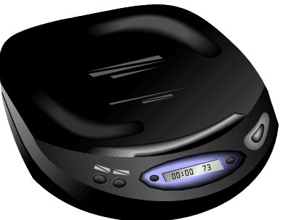
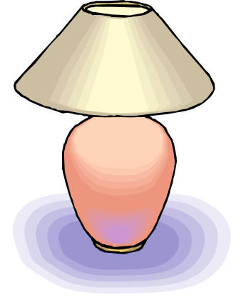
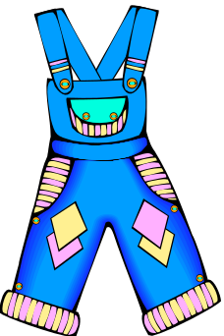
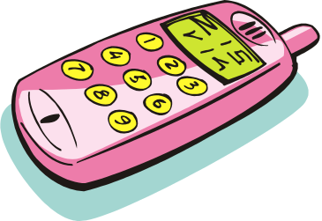
Reverse Percentages
The items below show the new price after the stated percentage increase. For each item use a multiplier to find the original price. (nearest 1p)
+21%
+18%
+5%
£95
£630
£320
1.21 x = 95 ⇒ x = 95/1.21
= £78.51
1.18 x = 630 ⇒ x = 630/1.18
= £533.90
1.05 x = 320 ⇒ x = 320/1.05
= £304.76
+34%
+42%
+63%
£24
£8.40
£48
1.34 x = 24 ⇒ x = 24/1.34
= £17.91
1.42 x = 8.40 ⇒ x = 8.40/1.42
= £5.92
1.63 x = 48 ⇒ x = 48/1.63
= £29.45

Slide 8
Reverse Percentages
A computer accessories shop has a sale and reduces all its prices by 10%. Simon bought a printer in the sale for £100. What was the original price?
+ 10% ?
£?
£100
- 10%
Original Price
Sale Price
Note that the answer cannot be £110 since £110 - 10% of £110 = £110 - £11 = £99 and not £100
£111.11
(to the nearest penny)
The situation is similar to before. You cannot calculate the original price simply by adding 10% on to the sale price. So we use a multiplier?

Slide 9
Reverse Percentages
A computer accessories shop has a sale and reduces all its prices by 10%. Simon bought a printer in the sale for £100. What was the original price?
£?
£100
- 10%
FINDING A MULTIPLIER
Original Price
Sale Price
The new price is 90% of the old price so the multiplier = 90/100 = 0.9
£111.11
(to the nearest penny)
So if x is the original price then: 0.9 x = 100 ⇒ x = 100/0.9 = £111.11

Slide 10
Reverse Percentages
Jenny bought a more expensive printer that included a fax machine and scanner. These were reduced by 12% in the sale. What was the original price? (nearest 1p)
£?
£260
- 12%
Original Price
New Price
The multiplier is 88/100 = 0.88
£295.45
(to the nearest penny)
0.88 x = 260 ⇒ x = 260/0.88 = £295.45

Slide 11
Reverse Percentages
Calculate the original price of the sideboard shown after it had been reduced in price by the indicated percentage.
£?
£450
- 25%
Original Price
Sale Price
The multiplier is 75/100 = 0.75
£600
(to the nearest penny)
0.75 x = 450 ⇒ x = 450/0.75 = £600

Slide 12
Reverse Percentages
Calculate the original price of the car shown after it had been reduced in price by the indicated percentage.
£?
£34000
- 4%
Original Price
Sale Price
The multiplier is 96/100 = 0.96
£35 400
(to the nearest £100)
0.96 x = 34 000 ⇒ x = 34 000/0.96 = £35 400

Slide 13
Reverse Percentages
The items below show the SALE price after the stated percentage decrease. For each item use a multiplier to find the original price. (nearest 1p)
-21%
-18%
-5%
£95
£630
£320
0.79 x = 95 ⇒ x = 95/0.79
= £120.25
0.82 x = 630 ⇒ x = 630/0.82
= £768.29
0.95 x = 320 ⇒ x = 320/0.95
= £336.84
- 34%
- 42%
- 63%
£24
£8.40
£48
0.66 x = 24 ⇒ x = 24/0.66
= £36.36
0.58 x = 8.40 ⇒ x = 8.40/0.58
= £14.48
0.37 x = 48 ⇒ x = 48/0.37
= £129.73

Slide 14
Worksheet 1
Reverse Percentages
The items below show the new price after the stated percentage increase. For each item use a multiplier to find the original price. (nearest 1p)
+21%
+18%
+5%
£95
£630
£320
+34%
+42%
+63%
£24
£8.40
£48

Slide 15
Worksheet 2
Reverse Percentages
The items below show the SALE price after the stated percentage decrease. For each item use a multiplier to find the original price. (nearest 1p)
-21%
-18%
-5%
£95
£630
£320
- 34%
- 42%
- 63%
£24
£8.40
£48

